Slide 1
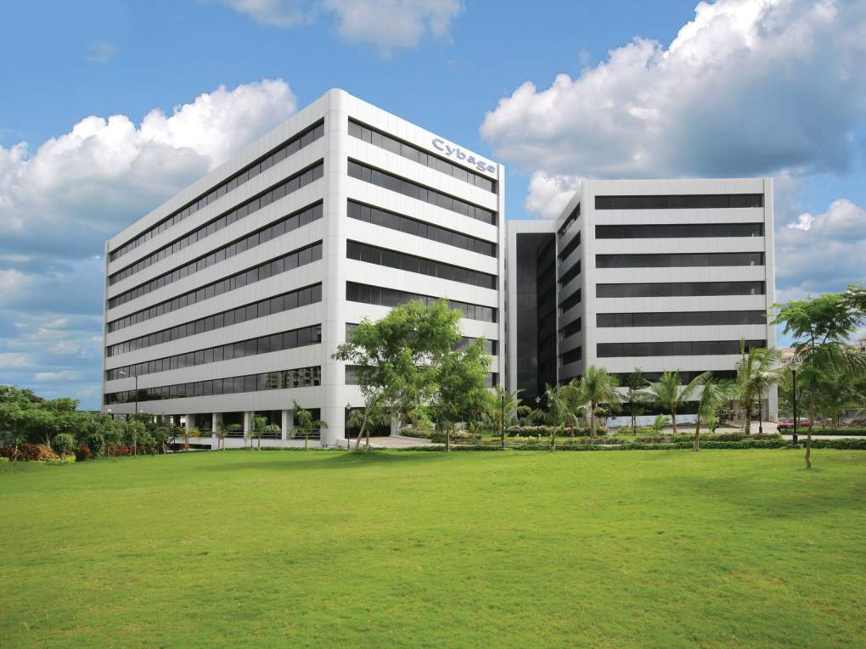

Application Lifecycle Management
Delivered By: Gajanan Patil-
Date: 29 Sept 2014
This document and all its contents contain information from Cybage Software Private Limited which may be privileged, confidential, or otherwise protected from disclosure. The information is intended to be for the addressee(s) only. Any unauthorized disclosure, copy, distribution, or use of the contents of this message is strictly prohibited.

Slide 2

ALM Insights
Introduction to ALM
Benefits of adopting ALM
Microsoft ALM
Atlassian ALM
Open Source ALM
ALM Implementation

Slide 3
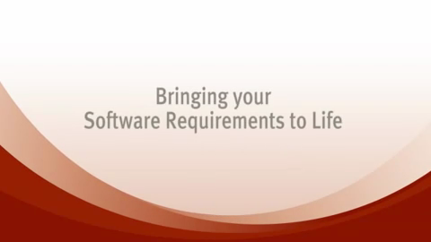
Unclear Objective

Slide 4

Practical Challenges
Development
Operations
Misunderstood Requirements
PRODUCT
BACKLOG
Can’t get actionable feedback
Can’t Reproduce production incident
Conflicting Priorities
Quality Suffers
Can’t Identify root cause
Sprint
Monitor
No Traceability
Losing focus
Late delivery
OPS
BACKLOG
Unmet user exceptions
WORKING SOFTWARE
Notes:
- BA’s, Devs, Testing teams were working in Silo.

Slide 5
Collaboration Process Traceability Quality
Governance Visibility
Requirements
Management
Deployment and Maintenance
Software Configuration Management
Development
ALM
Testing
Continuous
Integration
Project Management

Slide 6
What is ALM?
Application Lifecycle Management (ALM) is a continuous process of managing the life of an application through Governance, Development and Maintenance by effective Collaboration.

Slide 7
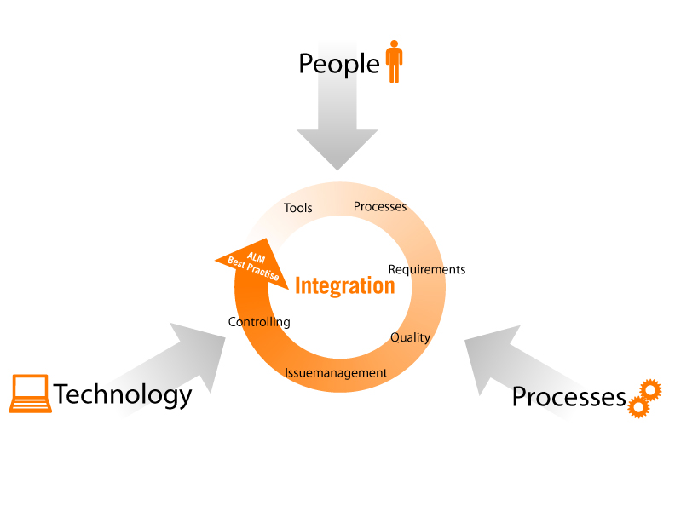
ALM in Sense

Slide 8
ALM - TFS
Collaboration Process Traceability Quality
Governance Visibility
Requirements
Management
Software Configuration Management
Testing
Design
ALM
Continuous
Integration
Development
Project Management

Slide 9
ALM - TFS
Collaboration Process Traceability Quality
ALM - TFS
Governance Visibility
Requirements
Management
Software Configuration Management
Testing
Design
ALM
Continuous
Integration
Development
Project Management

Slide 10

ALM - TFS
Collaboration Process Traceability Quality
Governance Visibility
TFS Work Items
Story Boarding, Feedback,
Backlog Management
Requirements
Management
Software Configuration Management
Testing
Design
ALM
Continuous
Integration
Development
Project Management

Slide 11
ALM - TFS
Collaboration Process Traceability Quality
Governance Visibility
Requirements
Management
Software Configuration Management
Testing
Design
ALM
Continuous
Integration
Development
Project Management

Slide 12
ALM - TFS
Collaboration Process Traceability Quality
Governance Visibility
Requirements
Management
Software Configuration Management
Testing
Design
ALM
VSTS Designer & Developer
Dependency Diagram,
Unit Testing, IntelliTrace, Context Switching, Code Analysis
Continuous
Integration
Development
Project Management

Slide 13
ALM - TFS
Collaboration Process Traceability Quality
Governance Visibility
Requirements
Management
Software Configuration Management
Testing
Design
ALM
Continuous
Integration
Development
Project Management

Slide 14
ALM - TFS
Collaboration Process Traceability Quality
Governance Visibility
Requirements
Management
Software Configuration Management
Testing
Design
ALM
MS Build
Build, Automation Test, Deployment configuration
Continuous
Integration
Development
Project Management

Slide 15
ALM - TFS
Collaboration Process Traceability Quality
Governance Visibility
Requirements
Management
Software Configuration Management
Testing
Design
ALM
Continuous
Integration
Development
Project Management

Slide 16
ALM - TFS
Collaboration Process Traceability Quality
Governance Visibility
Requirements
Management
Software Configuration Management
MTM
Test Management, Load Testing, Recording, Exploratory
Testing
Design
ALM
Continuous
Integration
Development
Project Management

Slide 17
ALM - TFS
Collaboration Process Traceability Quality
Governance Visibility
Requirements
Management
Software Configuration Management
Testing
Design
ALM
Continuous
Integration
Development
Project Management

Slide 18
ALM - TFS
Collaboration Process Traceability Quality
Governance Visibility
TFS
Version Control & Repository
Requirements
Management
Software Configuration Management
Testing
Design
ALM
Continuous
Integration
Development
Project Management

Slide 19
ALM - TFS
Collaboration Process Traceability Quality
Governance Visibility
Requirements
Management
Software Configuration Management
Testing
Design
ALM
Continuous
Integration
Development
Project Management

Slide 20
ALM - TFS
Collaboration Process Traceability Quality
Governance Visibility
Requirements
Management
Software Configuration Management
Testing
Design
ALM
Continuous
Integration
Development
TFS & SharePoint
Planning, Monitoring and Control, Reports, Collaboration
Project Management

Slide 21
ALM - TFS
Collaboration Process Traceability Quality
Governance Visibility
TFS Work Items
Story Boarding, Feedback,
Backlog Management
MTM
Test Management, Load Testing, Recording, Exploratory
Requirements
Management
Software Configuration Management
Testing
Design
Cybage
ALM
TFS
Version Control & Repository
VSTS Designer & Developer
Dependency Diagram,
Unit Testing, IntelliTrace, Context Switching, Code Analysis
MS Build
Build, Automation Test, Deployment configuration
Continuous
Integration
Development
TFS & SharePoint
Planning, Monitoring and Control, Reports, Collaboration
Project Management

Slide 22
ALM - Atlassian
Collaboration Process Traceability Quality
Governance Visibility
Requirements
Management
Software Configuration Management
Testing
Design
ALM
Continuous
Integration
Development
Project Management

Slide 23
ALM - Atlassian
Collaboration Process Traceability Quality
Governance Visibility
Requirements
Management
Software Configuration Management
Testing
Design
ALM
Continuous
Integration
Development
Project Management

Slide 24

ALM - Atlassian
Collaboration Process Traceability Quality
Governance Visibility
Requirements
Management
Software Configuration Management
Testing
Design
ALM
Continuous
Integration
Development
Project Management

Slide 25
ALM - Atlassian
Collaboration Process Traceability Quality
Governance Visibility
Requirements
Management
Software Configuration Management
Testing
Design
ALM
Continuous
Integration
Development
Project Management

Slide 26




ALM - Atlassian
Collaboration Process Traceability Quality
Governance Visibility
Requirements
Management
Software Configuration Management
Testing
Design
ALM
Continuous
Integration
Development
Project Management

Slide 27
ALM - Atlassian
Collaboration Process Traceability Quality
Governance Visibility
Requirements
Management
Software Configuration Management
Testing
Design
ALM
Continuous
Integration
Development
Project Management

Slide 28

ALM - Atlassian
Collaboration Process Traceability Quality
Governance Visibility
Requirements
Management
Software Configuration Management
Testing
Design
ALM
Continuous
Integration
Development
Project Management

Slide 29
ALM - Atlassian
Collaboration Process Traceability Quality
Governance Visibility
Requirements
Management
Software Configuration Management
Testing
Design
ALM
Continuous
Integration
Development
Project Management

Slide 30


ALM - Atlassian
Collaboration Process Traceability Quality
Governance Visibility
Requirements
Management
Software Configuration Management
Testing
Design
ALM
Continuous
Integration
Development
Project Management

Slide 31
ALM - Atlassian
Collaboration Process Traceability Quality
Governance Visibility
Requirements
Management
Software Configuration Management
Testing
Design
ALM
Continuous
Integration
Development
Project Management

Slide 32

ALM - Atlassian
Collaboration Process Traceability Quality
Governance Visibility
Requirements
Management
Software Configuration Management
Testing
Design
ALM
Continuous
Integration
Development
Project Management

Slide 33
ALM - Atlassian
Collaboration Process Traceability Quality
Governance Visibility
Requirements
Management
Software Configuration Management
Testing
Design
ALM
Continuous
Integration
Development
Project Management

Slide 34

ALM - Atlassian
Collaboration Process Traceability Quality
Governance Visibility
Requirements
Management
Software Configuration Management
Testing
Design
ALM
Continuous
Integration
Development
Project Management

Slide 35
ALM - Atlassian
Collaboration Process Traceability Quality
Governance Visibility
Requirements
Management
Software Configuration Management
Testing
Design
Cybage
ALM
Continuous
Integration
Development
Project Management

Slide 36
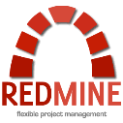











Open Source
Collaboration Process Traceability Quality
Governance Visibility
Requirements
Management
Software Configuration Management
Testing
Design
Cybage
ALM
Continuous
Integration
Development
Project Management
ALM - LAMP

Slide 37
ALM Implementation Stages
ALM Gaps Assessment
ALM Solution Proposal
ALM Tools Installation & Configuration
ALM Implementation

Slide 38
ALM Gaps Assessment
ALM maturity level assessment
Understanding existing scenario of project
Analyze the gathered information
Identify & prioritize improvement areas
Gap analysis of Processes and Tools
POC/R&D, if required.

Slide 39
ALM Solution Proposal
Recommend Process improvement areas
Recommend tools that can be adapted
Prepare roadmap for solution implementation.

Slide 40
Installation & Configuration of ALM Tools
Installation of the ALM tools
Configuration and customization of ALM tools
Integration of the ALM tools.

Slide 41
ALM Implementation
Training on tools and processes implementation
Migration of data (if Needed)
Reports customization (if Needed)
Analyze reports.

Slide 42
Thank you!

